Slide 1


Pablo Martínez Díaz
04/01/2024

Slide 2

Outline
Executive Summary
Introduction
Methodology
Results
Conclusion
Appendix

Slide 3
Executive Summary
Summary of methodologies
Data collection
Data wrangling
EDA with data visualization
EDA with SQL
Building an interactive map with Folium
Building a Dashboard with Plotly Dash
Predictive analysis (Classification)
Summary of all results
Exploratory data analysis results
Interactive analytics demo in screenshots
Predictive analysis results

Slide 4
Introduction
Project background and context
We predicted if the Falcon 9 first stage will land successfully. SpaceX advertises Falcon 9 rocket launches on its website, with a cost of 62 million dollars; other providers cost upward of 165 million dollars each, much of the savings is because SpaceX can reuse the first stage. Therefore, if we can determine if the first stage will land, we can determine the cost of a launch. This information can be used if an alternate company wants to bid against SpaceX for a rocket launch.
Problems you want to find answers
What influences if the rocket will land successfully?
The effect each relationship with certain rocket variables will impact in determining the success rate of a successful landing.
What conditions does SpaceX have to achieve to get the best results and ensure the best rocket success landing rate.

Slide 5

Section 1

Slide 6
Methodology
Executive Summary
Data collection methodology:
SpaceX Rest API
(Web Scrapping) from Wikipedia
Perform data wrangling
One Hot Encoding data fields for Machine Learning and dropping irrelevant columns
Perform exploratory data analysis (EDA) using visualization and SQL
Plotting : Scatter Graphs, Bar Graphs to show relationships between variables to show patterns of data.
Perform interactive visual analytics using Folium and Plotly Dash
Perform predictive analysis using classification models
How to build, tune, evaluate classification models

Slide 7
Data Collection
The following datasets was collected by
We worked with SpaceX launch data that is gathered from the SpaceX REST API.
This API will give us data about launches, including information about the rocket used, payload delivered, launch specifications, landing specifications, and landing outcome.
Our goal is to use this data to predict whether SpaceX will attempt to land a rocket or not.
The SpaceX REST API endpoints, or URL, starts with api.spacexdata.com/v4/.
Another popular data source for obtaining Falcon 9 Launch data is web scraping Wikipedia using BeautifulSoup.
SpaceX API
Web Scrapping
Use SpaceX REST API
API returns SpaceX data in .JSON
Normalize data into flat data file such as .csv
Get HTML response from wikipedia
Extract data using beautiful soup
Normalize data into flat data file such as .csv

Slide 8
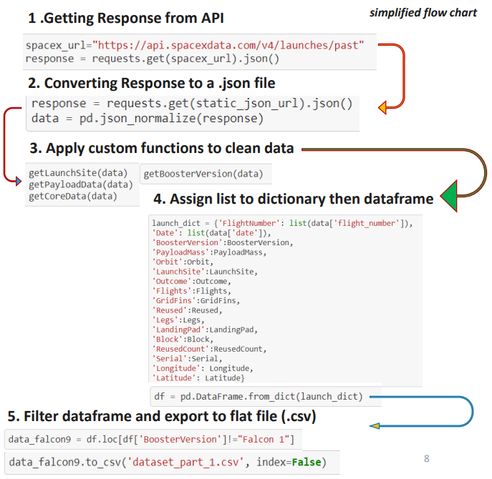
Data Collection – SpaceX API
Use SpaceX REST API
Filter DF for Falcon 9 Only / Clean Data
API Returns SpaceX data in .JSON
Normalize data into flat data file such as .csv
GitHub Link

Slide 9
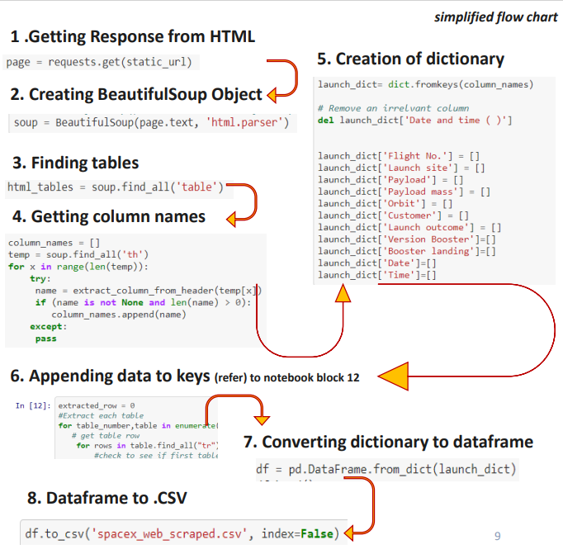
Data Collection - Scraping
Get HTML Response from Wikipedia
Extract data using beautiful soup
Parse HTML table into a list -> Dictionary
Normalize data into flat file such as .csv
Place your flowchart of web scraping here
GitHub Link

Slide 10
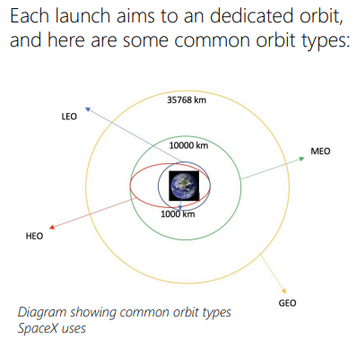
Data Wrangling
GitHub Link
Describe how data were processed
In the data set, there are several different cases where the booster did not land successfully. Sometimes a landing was attempted but failed due to an accident; for example, True Ocean means the mission outcome was successfully landed to a specific region of the ocean while False Ocean means the mission outcome was unsuccessfully landed to a specific region of the ocean. True RTLS means the mission outcome was successfully landed to a ground pad False RTLS means the mission outcome was unsuccessfully landed to a ground pad. True ASDS means the mission outcome was successfully landed on a drone ship False ASDS means the mission outcome was unsuccessfully landed on a drone ship. We mainly convert those outcomes into Training Labels with 1 means the booster successfully landed 0 means it was unsuccessful.
Perform exploratory data análisis EDA on dataset
Calculate the numer of launches at each site
Calculate the number and occurrence of misión outcome per orbit type
Export dataset as .CSV
Calculate the number and occurrence of each orbit
Create a landing outcome label from Outcome column
Work out success rate for every landing in dataset

Slide 11
EDA with Data Visualization
GitHub Link
Summarize what charts were plotted and why you used those charts
Flight Number VS. Payload Mass
Flight Number VS. Launch Site
Payload VS. Launch Site
Orbit VS. Flight Number
Payload VS. Orbit Type
Orbit VS. Payload Mass
Scatter plots show how much one variable is affected by another. The relationship between two variables is called their correlation . Scatter plots usually consist of a large body of data

Slide 12
EDA with SQL
GitHub Link
Using bullet point format, summarize the SQL queries you performed
Displaying the names of the unique launch sites in the space mission
Displaying 5 records where launch sites begin with the string 'KSC’
Displaying the total payload mass carried by boosters launched by NASA (CRS)
Displaying average payload mass carried by booster version F9 v1.1
Listing the date where the successful landing outcome in drone ship was achieved.
Listing the names of the boosters which have success in ground pad and have payload mass greater than 4000 but less than 6000
Listing the total number of successful and failure mission outcomes
Listing the names of the booster_versions which have carried the maximum payload mass.
Listing the records which will display the month names, successful landing_outcomes in ground pad , booster versions, launch_site for the months in year 2017
Ranking the count of successful landing_outcomes between the date 2010-06-04 and 2017-03-20 in descending order

Slide 13
Build an Interactive Map with Folium
GitHub Link
To visualize the Launch Data into an interactive map.
We took the Latitude and Longitude Coordinates at each launch site and added a Circle Marker around each launch site with a label of the name of the launch site.
We assigned the dataframe launch_outcomes(failures, successes) to classes 0 and 1 with Green and Red markers on the map in a MarkerCluster()
Using Haversine’s formula we calculated the distance from the Launch Site to various landmarks to find various trends about what is around the Launch Site to measure patterns. Lines are drawn on the map to measure distance to landmarks
Example of some trends in which the Launch Site is situated in.
Are launch sites in close proximity to railways? No
Are launch sites in close proximity to highways? No
Are launch sites in close proximity to coastline? Yes
Do launch sites keep certain distance away from cities? Yes

Slide 14
Build a Dashboard with Plotly Dash
GitHub Link
Used Python Anywhere to host the website live 24/7 so your can play around with the data and view the data
The dashboard is built with Flask and Dash web framework.
Graphs
Pie Chart showing the total launches by a certain site/all sites - display relative proportions of multiple classes of data. - size of the circle can be made proportional to the total quantity it represents
Scatter Graph showing the relationship with Outcome and Payload Mass (Kg) for the different Booster Versions
It shows the relationship between two variables.
It is the best method to show you a non-linear pattern.
The range of data flow, i.e. maximum and minimum value, can be determined.
Observation and reading are straightforward

Slide 15
Predictive Analysis (Classification)
GitHub Link
BUILDING MODEL
Load our dataset into NumPy and Pandas
Transform Data
Split our data into training and test data sets
Check how many test samples we have
Decide which type of machine learning algorithms we want to use
Set our parameters and algorithms to GridSearchCV
Fit our datasets into the GridSearchCV objects and train our dataset.
EVALUATING MODEL
Check accuracy for each model
Get tuned hyperparameters for each type of algorithms
Plot Confusion Matrix
IMPROVING MODEL
Feature Engineering
Algorithm Tuning
FINDING THE BEST PERFORMING CLASSIFICATION MODEL
The model with the best accuracy score wins the best performing model
In the notebook there is a dictionary of algorithms with scores at the bottom of the notebook

Slide 16
Results
Exploratory data analysis results
Interactive analytics demo in screenshots
Predictive analysis results

Slide 17

Section 2

Slide 18
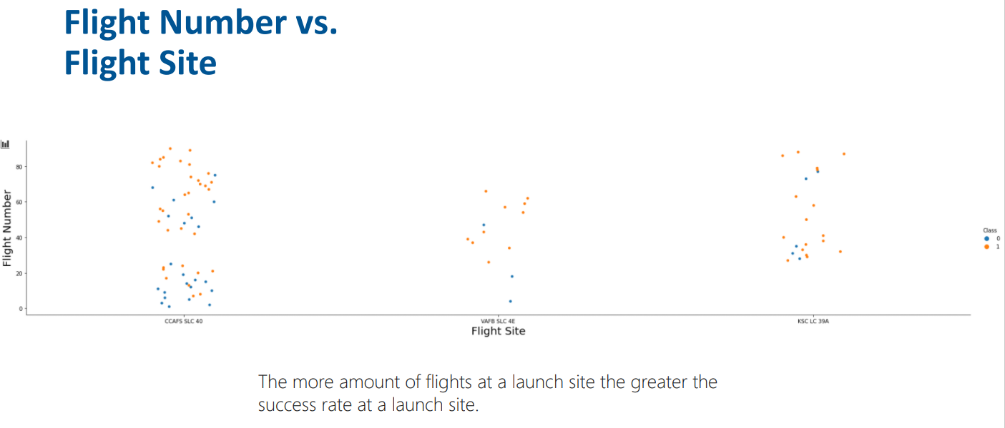
Flight Number vs. Launch Site

Slide 19
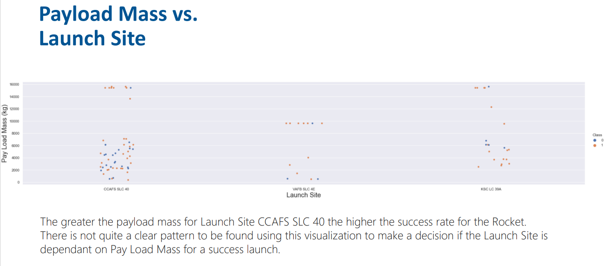
Payload vs. Launch Site

Slide 20
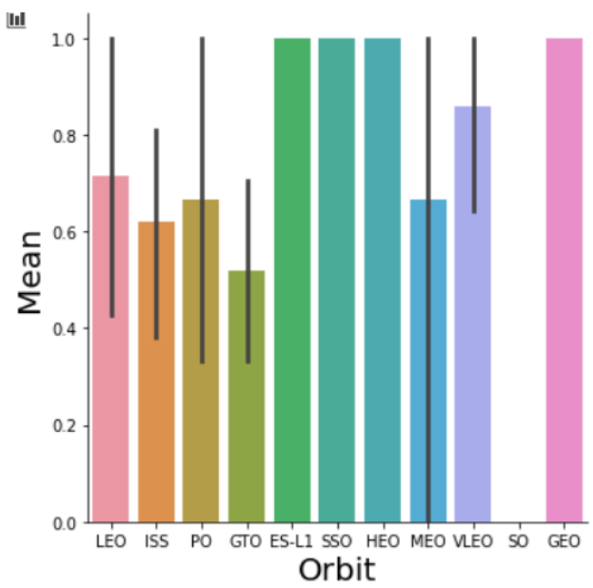
Success Rate vs. Orbit Type
Orbit GEO,HEO,SSO,ES-L1 has the best Success Rate

Slide 21
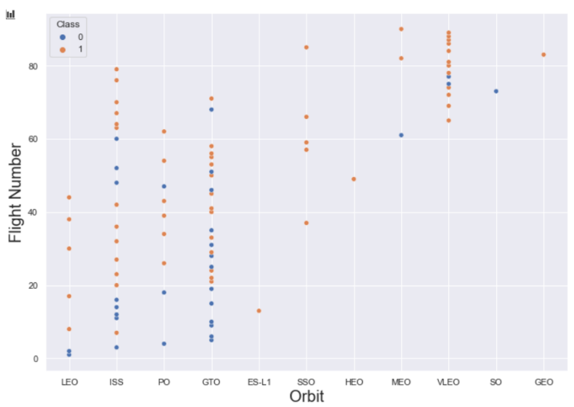
Flight Number vs. Orbit Type
You should see that in the LEO orbit the Success appears related to the number of flights; on the other hand, there seems to be no relationship between flight number when in GTO orbit.

Slide 22
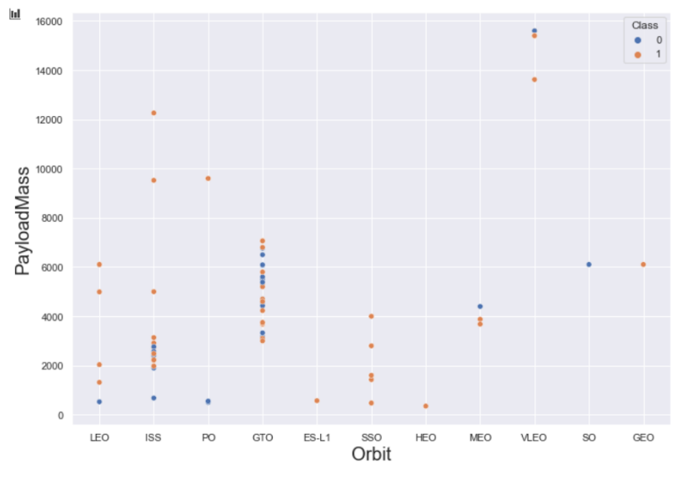
Payload vs. Orbit Type
You should observe that Heavy payloads have a negative influence on GTO orbits and positive on GTO and Polar LEO (ISS) orbits.

Slide 23
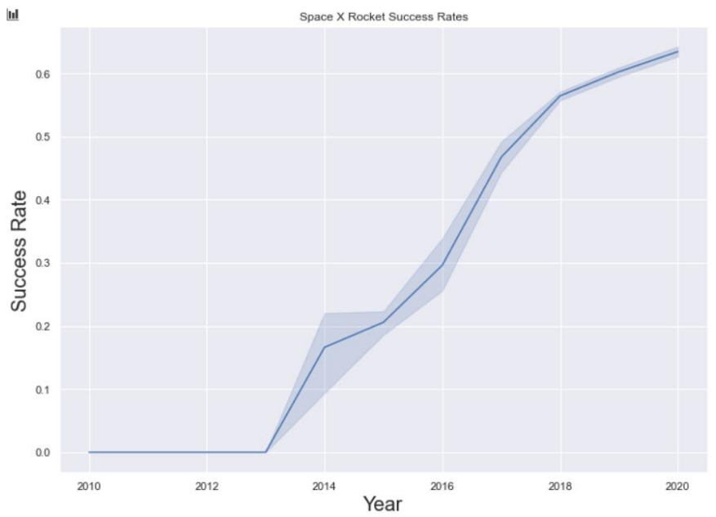
Launch Success Yearly Trend
you can observe that the success rate since 2013 kept increasing till 2020.

Slide 24
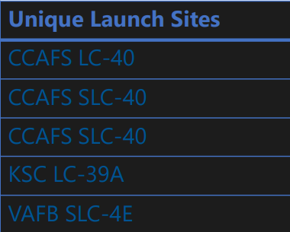
All Launch Site Names
SQL Query:
select DISTINCT Launch_Site from tblSpaceX
Query Explanation
Using the word DISTINCT in the query means that it will only show Unique values in the Launch_Site column from tblSpaceX

Slide 25
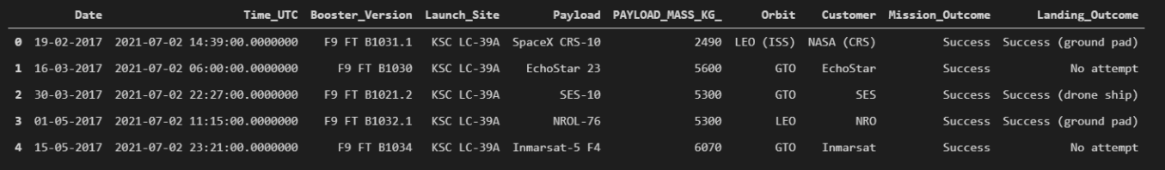
Launch Site Names Begin with 'CCA'
SQL Query:
select TOP 5 * from tblSpaceX WHERE Launch_Site LIKE 'KSC%'
Query Explanation
Using the word TOP 5 in the query means that it will only show 5 records from tblSpaceX and LIKE keyword has a wild card with the words ‘KSC%’ the percentage in the end suggests that the Launch_Site name must start with KSC.

Slide 26
Total Payload Mass
SQL Query:
select SUM(PAYLOAD_MASS_KG_) TotalPayloadMass from tblSpaceX where Customer = 'NASA (CRS)'",'TotalPayloadMass
Query explanation
Using the function SUM summates the total in the column PAYLOAD_MASS_KG_ The WHERE clause filters the dataset to only perform calculations on Customer NASA (CRS)

Slide 27
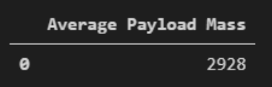
Average Payload Mass by F9 v1.1
SQL Query:
select AVG(PAYLOAD_MASS_KG_) AveragePayloadMass from tblSpaceX where Booster_Version = 'F9 v1.1'
Query Explanation
Using the function AVG works out the average in the column PAYLOAD_MASS_KG_ The WHERE clause filters the dataset to only perform calculations on Booster_version F9 v1.1

Slide 28

First Successful Ground Landing Date
SQL Query:
select MIN(Date) SLO from tblSpaceX where Landing_Outcome = ”Success (drone ship)”
Query Explanation
Using the function MIN works out the minimum date in the column DateThe WHERE clause filters the dataset to only perform calculations on Landing_Outcome Success (drone ship)

Slide 29
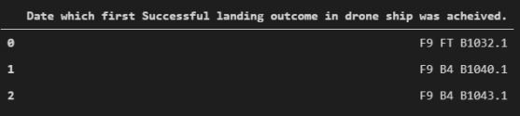
Successful Drone Ship Landing with Payload between 4000 and 6000
SQL Query
select Booster_Version from tblSpaceX where Landing_Outcome = 'Success (ground pad)’ AND Payload_MASS_KG_ > 4000 AND Payload_MASS_KG_ < 6000
Query explanation
Selecting only Booster_Version The WHERE clause filters the dataset to Landing_Outcome = Success (drone ship) The AND clause specifies additional filter conditions Payload_MASS_KG_ > 4000 AND Payload_MASS_KG_ < 6000

Slide 30
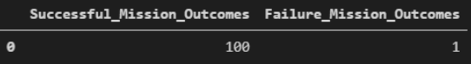
Total Number of Successful and Failure Mission Outcomes
SQL Query:
SELECT(SELECT Count(Mission_Outcome) from tblSpaceX where Mission_Outcome LIKE '%Success%’) as Successful_Mission_Outcomes, (SELECT Count(Mission_Outcome) from tblSpaceX where Mission_Outcome LIKE '%Failure%’) as Failure_Mission_Coutcomes
Query explanation
A much harder query I must say, we used subqueries here to produce the results. The LIKE ‘%foo%’ wildcard shows that in the record the foo phrase is in any part of the string in the records for example. PHRASE “(Drone Ship was a Success)” LIKE ‘%Success%’ Word ‘Success’ is in the phrase the filter will include it in the dataset

Slide 31
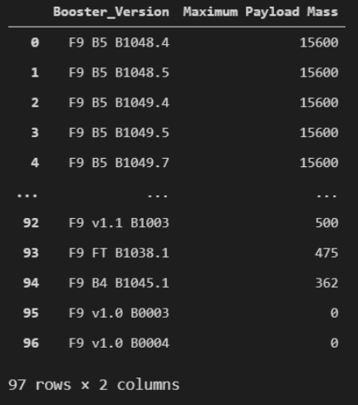
Boosters Carried Maximum Payload
SQL Query:
SELECT DISTINCT Booster_Version, MAX(PAYLOAD_MASS_KG_) AS [Maximum Payload Mass] FROM tblSpaceX GROUP BY Booster_Version ORDER BY [Maximum Payload Mass] DESC
Query explanation
Using the word DISTINCT in the query means that it will only show Unique values in the Booster_Version column from tblSpaceX GROUP BY puts the list in order set to a certain condition. DESC means its arranging the dataset into descending order

Slide 32
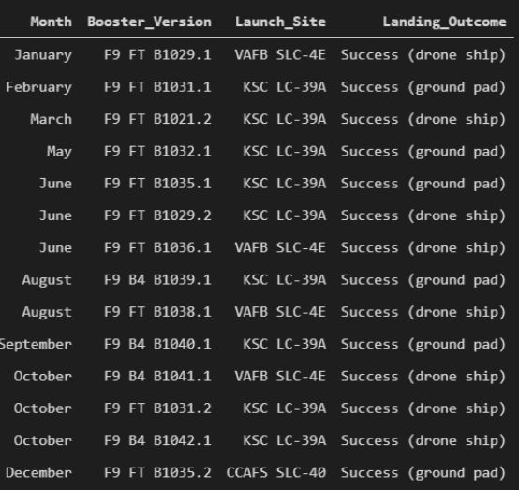
2015 Launch Records
SQL Query:
SELECT DATENAME(month, DATEADD(month, MONTH(CONVERT(date, Date, 105)), 0) - 1) AS Month, Booster_Version, Launch_Site, Landing_Outcome FROM tblSpaceX WHERE (Landing_Outcome LIKE N'%Success%') AND (YEAR(CONVERT(date, Date, 105)) = '2017')
Query explanation
A much more complex query as I had my Date fields in SQL Server stored as NVARCHAR the MONTH function returns name month. The function CONVERT converts NVARCHAR to Date. WHERE clause filters Year to be 2017

Slide 33
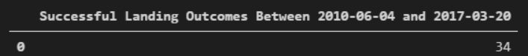
Rank Landing Outcomes Between 2010-06-04 and 2017-03-20
SQL Query:
SELECT COUNT(Landing_Outcome) FROM tblSpaceX WHERE (Landing_Outcome LIKE '%Success%’) AND (Date > '04-06-2010’) AND (Date < '20-03-2017')
Query explanation
Function COUNT counts records in column WHERE filters data LIKE (wildcard) AND (conditions) AND (conditions)

Slide 34

Section 3

Slide 35
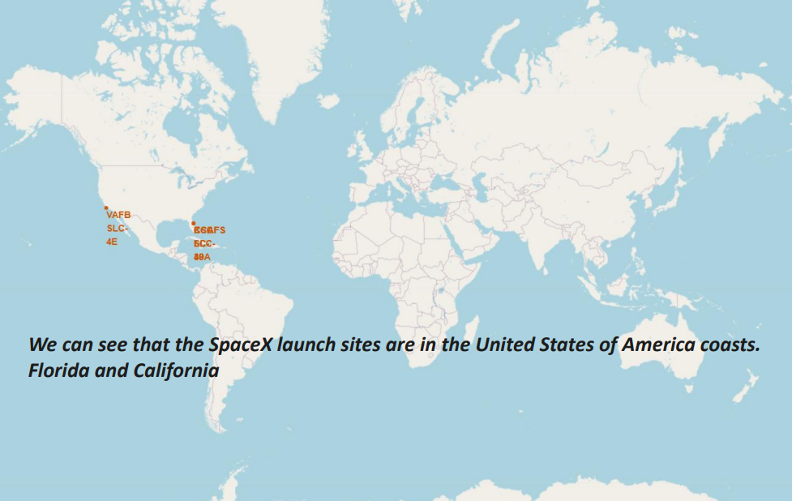
<Folium Map Screenshot 1>

Slide 36
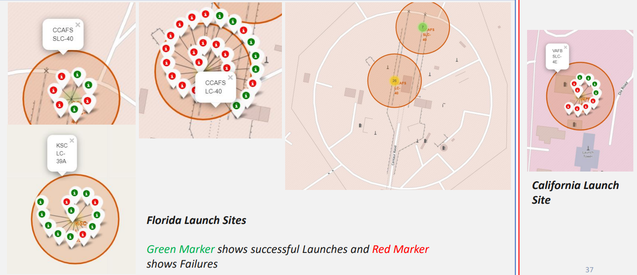

<Folium Map Screenshot 2>

Slide 37
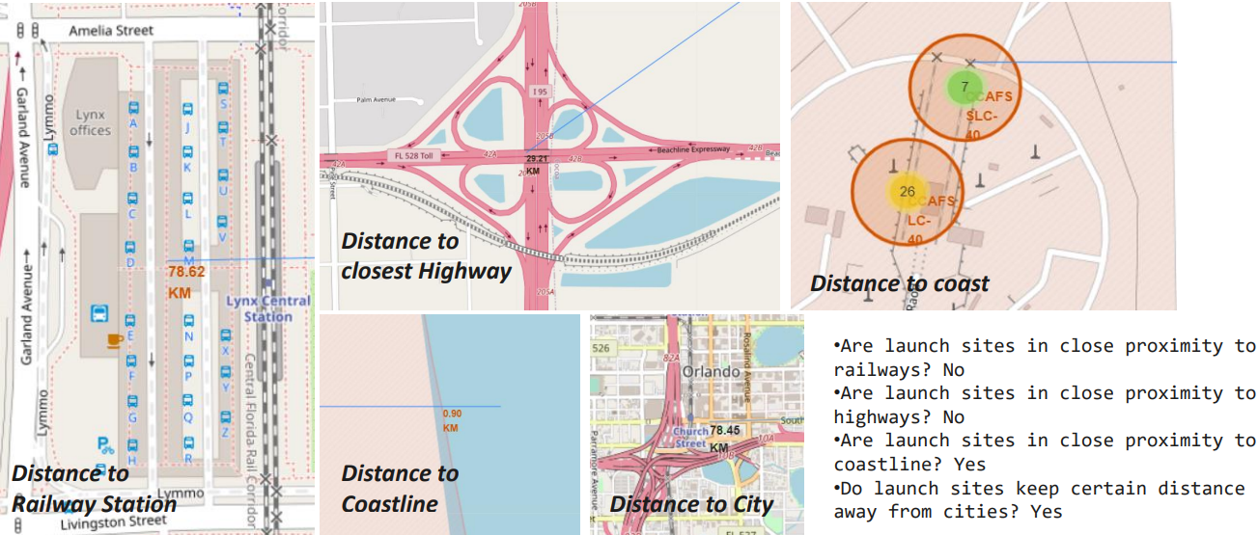
<Folium Map Screenshot 3>

Slide 38

Section 4

Slide 39
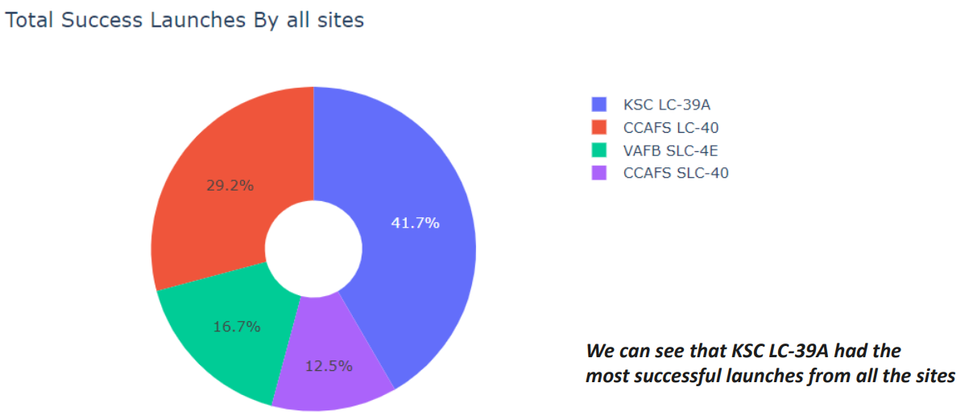
<Dashboard Screenshot 1>

Slide 40
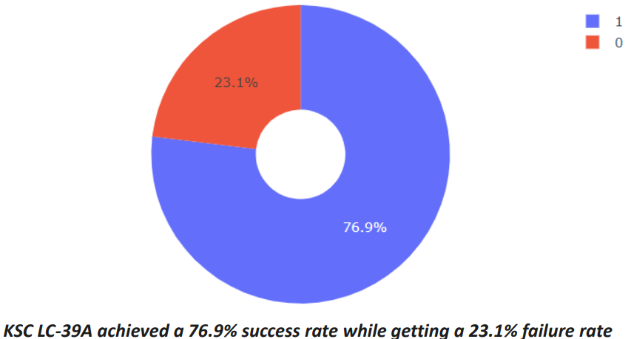
<Dashboard Screenshot 2>

Slide 41
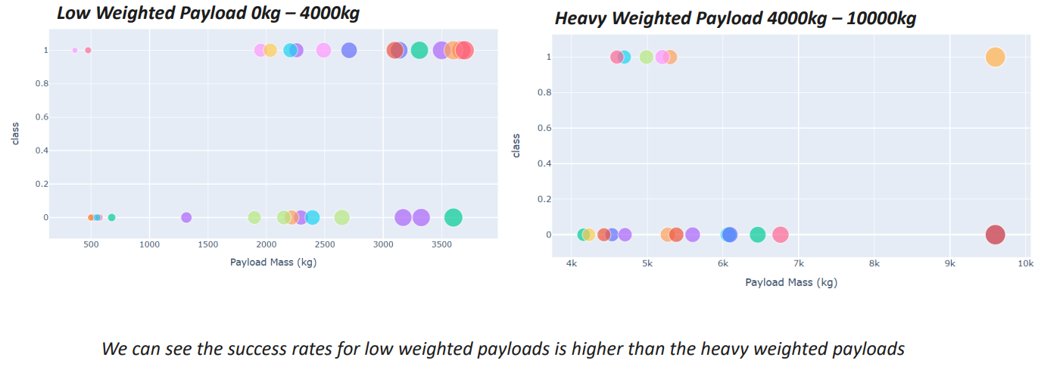
<Dashboard Screenshot 3>

Slide 42

Section 5

Slide 43
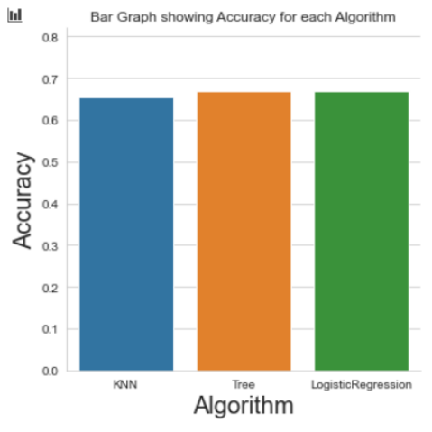
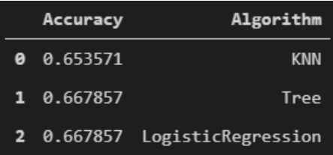
Classification Accuracy
As you can see our accuracy is extremely close but we do have a winner its down to decimal places! using this function
The tree algorithm is better
After selecting the best hyperparameters for the decision tree classifier using the validation data, we achieved 83.33% accuracy on the test data.

Slide 44
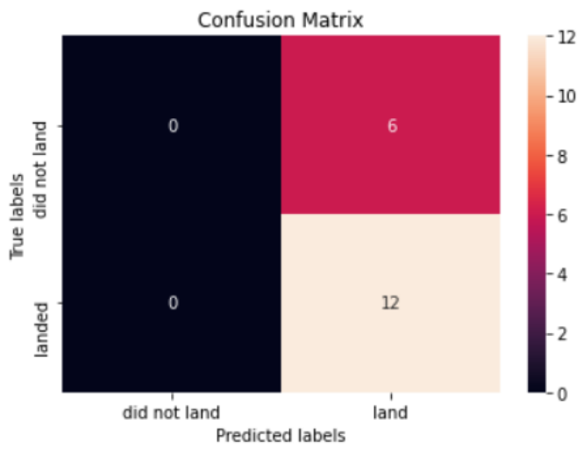
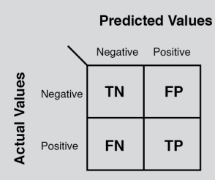
Confusion Matrix
Examining the confusion matrix, we see that Tree can distinguish between the different classes. We see that the major problem is false positives.

Slide 45
Conclusions
The Tree Classifier Algorithm is the best for Machine Learning for this dataset
Low weighted payloads perform better than the heavier payloads
The success rates for SpaceX launches is directly proportional time in years they will eventually perfect the launches
We can see that KSC LC-39A had the most successful launches from all the sites
Orbit GEO,HEO,SSO,ES-L1 has the best Success Rate

Slide 46
Appendix
Haversine formula
ADGGoogleMaps Module (not used but created)
Module sqlserver (ADGSQLSERVER)
PythonAnywhere 24/7 dashboard

Slide 47
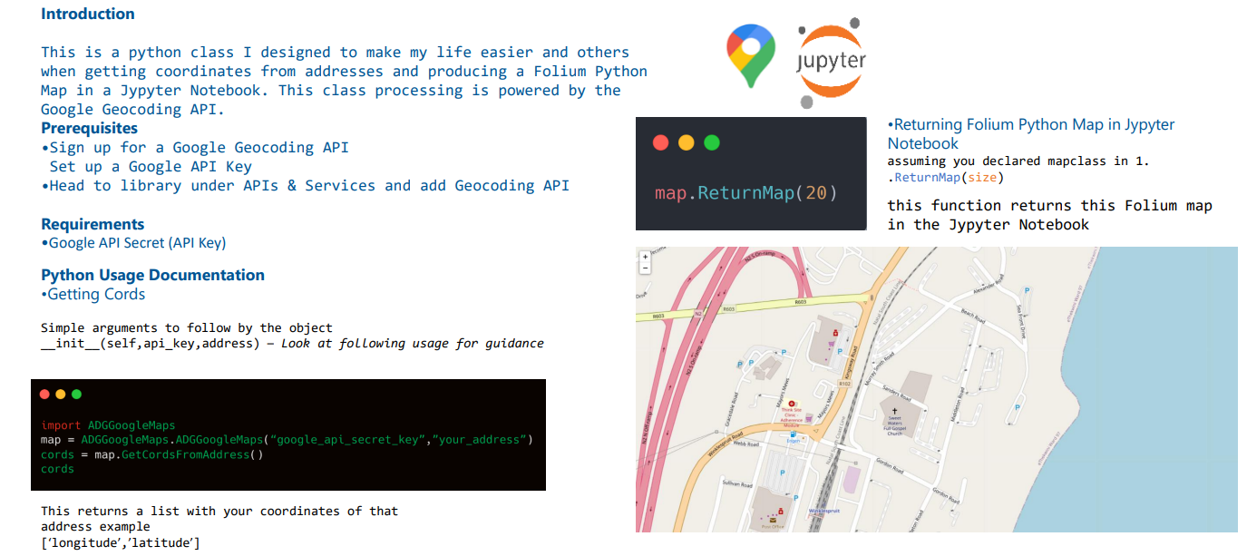
ADGGoogleMaps

Slide 48


